Slide 1
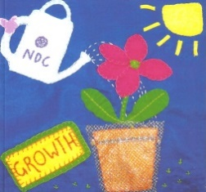
Notre Dame Centre
Young People’s Programme
www.seasonsforgrowth.org.uk

Slide 2
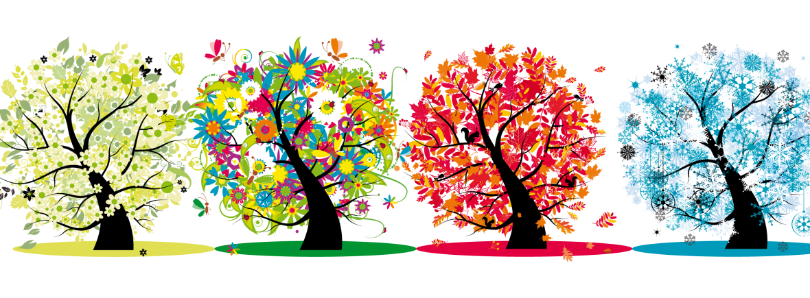
What is Change?
‘The only constant in life is change’
Fallin, 2013

Slide 3
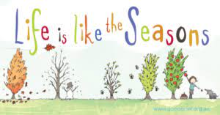
Seasons for Growth is:
A programme for students who have experienced changes in their lives because of a significant loss, death, separation or divorce.
Seasons for Growth is an 8-week programme where you learn how to cope when difficult things like this happen by exploring a range of issues associated with change and loss, and how we can respond and adapt.

Slide 4
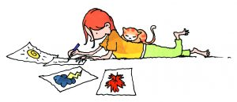
How will the programme operate at St Thomas’s?
Groups of 4 – 7 young people.
8 sessions over 8 weeks.
Facilitated by the Support for Learning Department and Place2Be

Slide 5
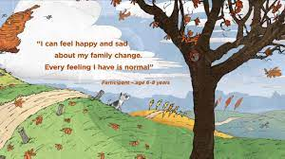
Seasons for growth will help you:
Understand change.
Learn new skills to cope effectively with change and loss.
Increase your self- esteem.
Manage your feelings.
Make new friends.

Slide 6
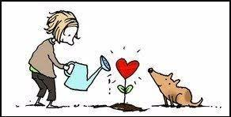
If this is something you would think you would benefit from then please speak to Ms Moreno in Support for Learning or your Pupil Support Leader.

