Slide 1
Applying to University
A brief guide
www.ed.ac.uk
applyedinburgh

Slide 2
Which subject?
Over 50,000 courses to choose from…
Take a school subject to the next level?
Related subjects?
Something completely new?
Vocational courses?
Try to choose a subject that’s enjoyable!
www.ed.ac.uk
applyedinburgh

Slide 3
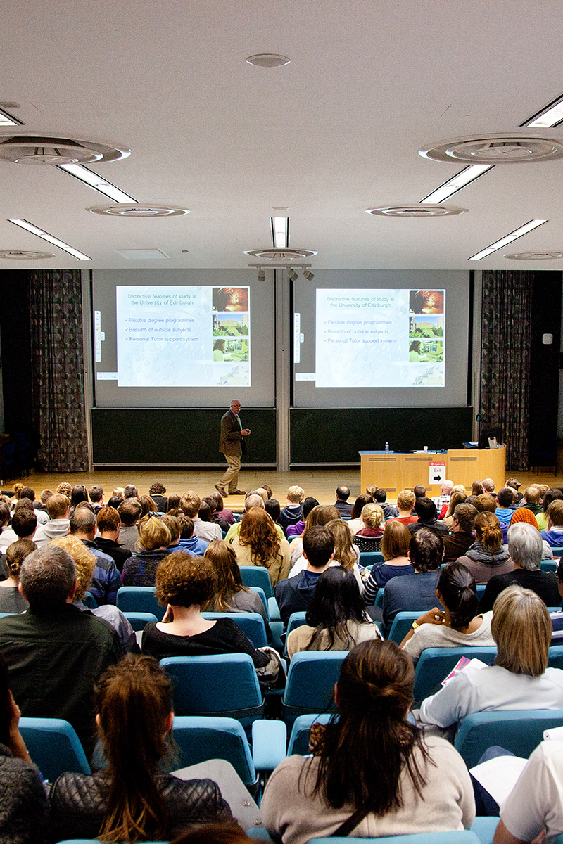
Which course?
Research:
Course content
Flexibility
Teaching and assessment methods
Quality of teaching and research
Professional accreditation
Placements / study abroad?
Future career paths
www.ed.ac.uk
applyedinburgh

Slide 4
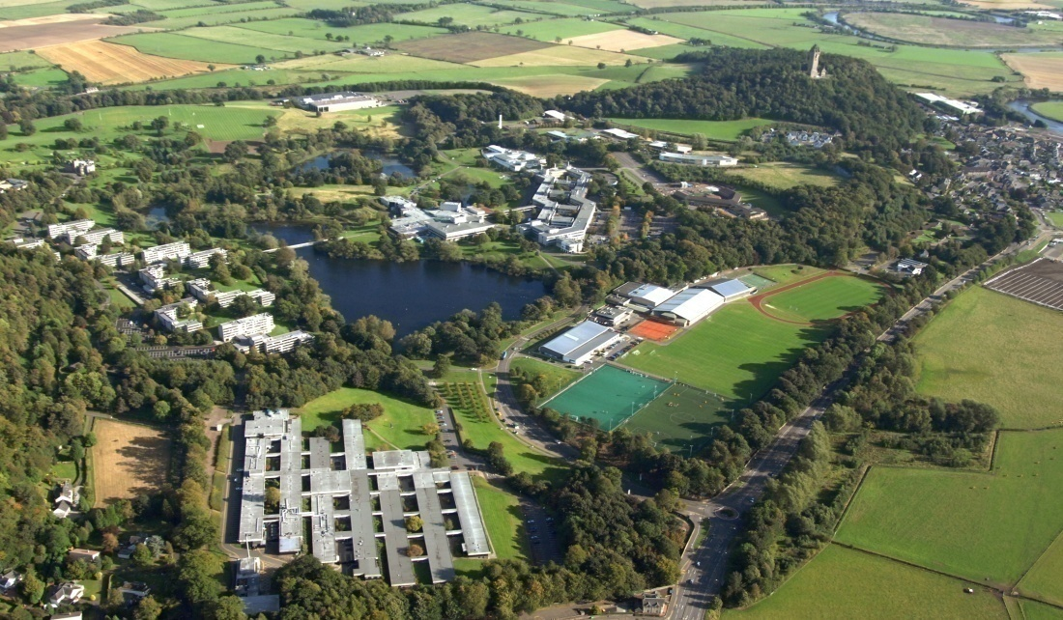
Which university?
What sort of environment will suit the student best?
Location?
Big or small?
Campus or city?
www.ed.ac.uk
applyedinburgh

Slide 5
Which university?
Consider university facilities:
Academic facilities and resources
Accommodation options
Student support and welfare
Scholarships or bursaries
Social and sports facilities
Societies and sports clubs
Think beyond the university:
Entertainment
Study resources
Possible places to work
www.ed.ac.uk
applyedinburgh

Slide 6
Admissions checklist
‘Minimum’ requirement vs ‘standard’ offer
Subject specific?
General entry requirements?
Qualifications over multiple years?
Advanced Highers recommended/ required?
Work experience?
Additional tests e.g. UCAT, LNAT?
Interview?
Portfolio?
Alternative routes?
If in doubt, check with the University directly before applying!
www.ed.ac.uk
applyedinburgh

Slide 7
Example:
BSc Biological Sciences at Edinburgh
Standard entry requirement
SQA Highers: AAAA - AAAB by end of S5. If you haven’t achieved this by the end of S5 we may consider your application based on a strong performance in S6. A minimum of BBB must be achieved in one year of S4-S6
Minimum entry requirement
The minimum entry requirement for widening access applicants is:
SQA Highers: AABB by end of S6, with a minimum of BBB achieved in one year of S4-S6.
Required subjects
The grades used to meet our entry requirements must include:
SQA: Higher: Biology and Chemistry. Grade A is required in one of Biology, Chemistry, Mathematics or Physics. Qualified applicants are strongly advised to take Biology and Chemistry at Advanced Higher level where possible. National 5: Mathematics or Physics at grade B.
14/11/19. https://www.ed.ac.uk/studying/undergraduate/degrees/index.php?action=view&code=C100
www.ed.ac.uk
applyedinburgh

Slide 8
Example:
BSc Biological Sciences at Heriot-Watt
Standard entry requirements
Highers AABB/ABBBB (including a science subject)
HNC C in graded unit (in relevant HNC)
Minimum entry requirements*
Highers BBBC (including a science subject at B)
Additional information Suitable science subjects are Biology, Chemistry, Environmental Sciences, Human Biology, Mathematics and Physics.
*Minimum: under our Fair Access Policy, we will relax our standard entry requirements for Scottish students depending on their circumstances.
We can also make exceptions for some Scottish students with grades above minimum but below standard.
14/11/19. https://www.hw.ac.uk/study/uk/undergraduate/biological-sciences.htm
www.ed.ac.uk
applyedinburgh

Slide 9
What are admissions staff looking for?
Academic achievement and potential to do well at university
Evidence (via personal statement) of:
suitability for the programme and a strong interest in the subject area(s)
commitment, motivation and readiness for higher education
if applying to a vocational programme, an understanding of the profession.
Supporting school reference
www.ed.ac.uk
applyedinburgh

Slide 10
Research!
University prospectuses & course leaflets
University websites
Contact universities directly
UCAS website
Independent guides
Careers library
Higher Education Exhibitions
Work experience / shadowing?
Open Days!
www.ed.ac.uk
applyedinburgh

Slide 11
Useful websites
Finance:
www.saas.gov.uk
www.ed.ac.uk/student-funding
UCAS Search:
https://digital.ucas.com/search
Open Days:
www.opendays.com
University of Edinburgh:
www.ed.ac.uk
www.ed.ac.uk
applyedinburgh

