Slide 1
St Thomas of Aquin’s RC High School 2020 senior information evening
Attainment presentation
Insight
S4 attainment
S5 attainment
S6 attainment

Slide 2
Insight – National and HMIe evaluation
SQA Exam data (A-D)
Census Information
Entered at School level on SEEMiS
ASN/EAL Characteristics
LAC status
Gender
Stage (ie S4)
Ethnicity
Other Awards Providers (SCQF aligned)
SIMD Information
http://www.gov.scot/Topics/Statistics/SIMD
Skills Development Scotland leavers’ information and destinations

Slide 3
Insight – Virtual Comparator
St Thomas pupil
Gender
Stage
ASN status
SIMD status
Achievement A-D + other awards
10 Learners with similar characteristics
Outwith St Thomas Local Authority
Average achievement

Slide 4
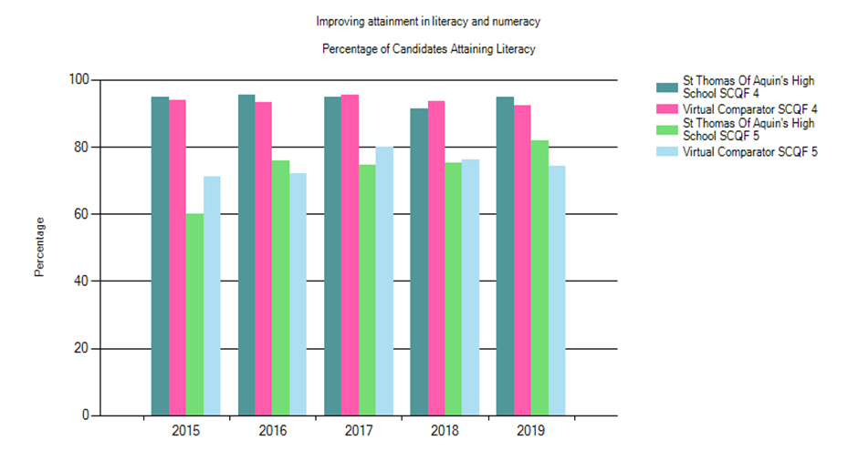
St Thomas of Aquin’s 2018-19 Attainment Report Percentage of S4 Candidates Attaining Literacy (SCQF levels 4 and 5)

Slide 5
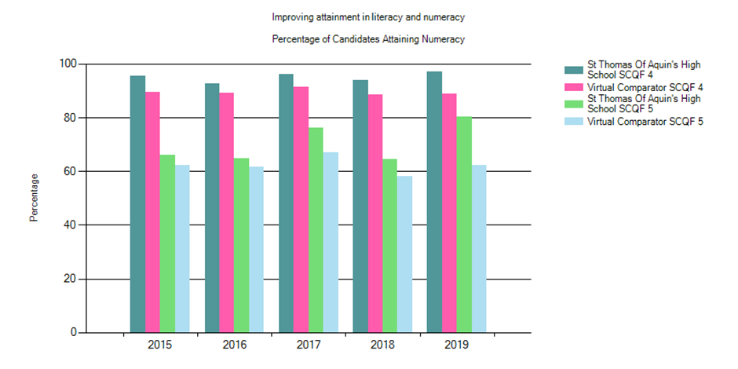
St Thomas of Aquin’s 2018-19 Attainment Report Percentage of S4 Candidates Attaining Numeracy (SCQF levels 4 and 5)

Slide 6
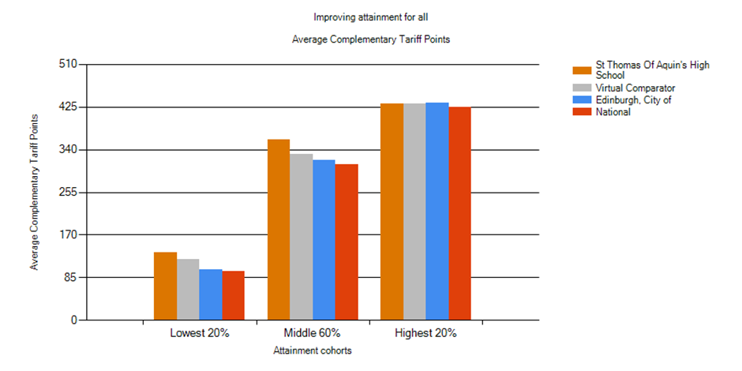
St Thomas of Aquin’s Attainment Report: S4 Improving Attainment for All – S4 (all candidates) Lowest 20% & Middle 60% improved from 2017-18 attainment - Curriculum (8 to 7 Nationals) & S4 at risk focus? 2018-19 5@ Level 5 67% is the school’s highest attainment in S4 2017-18 Level 3 = 86%. Level 4 = 82%. Level 5 = 62% 2016-17 5@ Level 5 was 64%
Awards | Level 3 | Level 4 | Level 5
1 or more | 98.55% | 97.83% | 87.68%
2 or more | 98.55% | 95.65% | 79.71%
3 or more | 97.10% | 92.75% | 73.91%
4 or more | 95.65% | 90.58% | 71.74%
5 or more | 92.75% | 86.96% | 66.67%

Slide 7
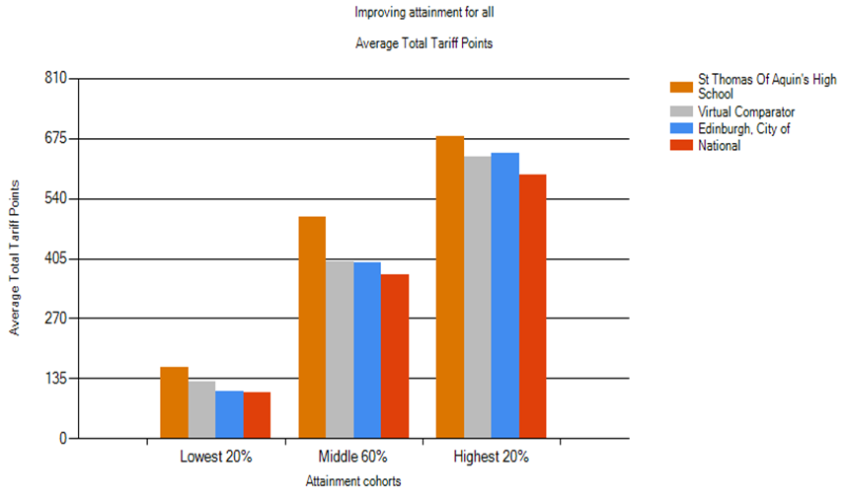
St Thomas of Aquin’s Attainment Report: S4 Improving Attainment for All – S4 (all candidates) Average tariff points based rather than complimentary tariff score – the average of the 7 or 8 NQs pupils sat
2018-19 Data: S4 attainment based on S4 cohort numbers
S4 St Thomas of Aquin’s Lowest 20%, Middle 60%, and Highest 20% statistic: 161/499/681
S4 VC Lowest 20%, Middle 60%, and Highest 20% statistic: 129/398/634
S4 CEC Lowest 20%, Middle 60%, and Highest 20% statistic: 106/396/641
S4 National Lowest 20%, Middle 60%, and Highest 20% statistic: 103/369/594

Slide 8
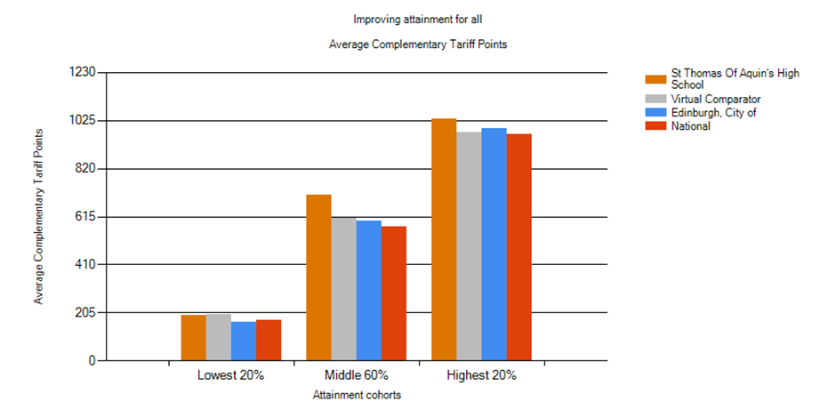
St Thomas of Aquin’s Attainment Report: Improving Attainment for All – S5 (all candidates) Lowest 20%, Middle 60%, and Highest 20% has improved – gap between middle 60% and Highest 20% widened against VC 5@ Level 6 (41%) is down from 2017-18 5@ Level 6 43% & 3@ Level 6 (61%) is down from 2017-18 (62.5%) 5@ Level 6 was 31% in 2016-17
Awards | Level 5 | Level 6
1 or more | 90.68% | 77.97%
2 or more | 88.14% | 70.34%
3 or more | 84.75% | 61.02%
4 or more | 80.51% | 53.39%
5 or more | 71.19% | 40.68%

Slide 9
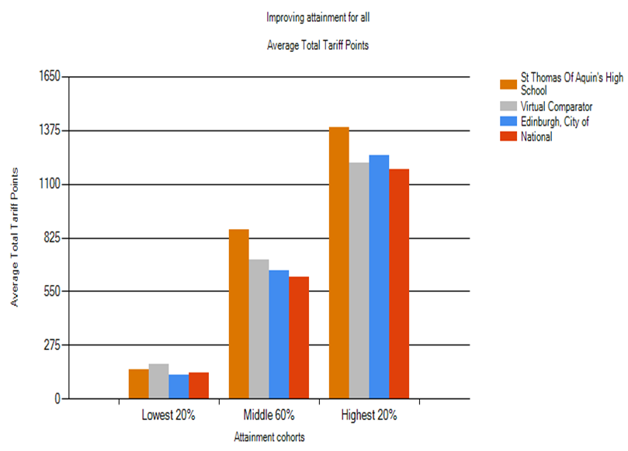
St Thomas of Aquin’s Attainment Report: S5 Improving Attainment for All – S5 (all candidates) Average tariff points based rather than complimentary tariff score: the average of the 5 NQs pupils sat
2018-19 Data: S5 attainment based on S4 cohort numbers
S5 St Thomas of Aquin’s Lowest 20%, Middle 60%, and Highest 20% statistic: 152/867/1389
S5 VC Lowest 20%, Middle 60%, and Highest 20% statistic: 178/711/1211
S5 CEC Lowest 20%, Middle 60%, and Highest 20% statistic: 125/656/1244
S5 National Lowest 20%, Middle 60%, and Highest 20% statistic: 132/626/1175

Slide 10
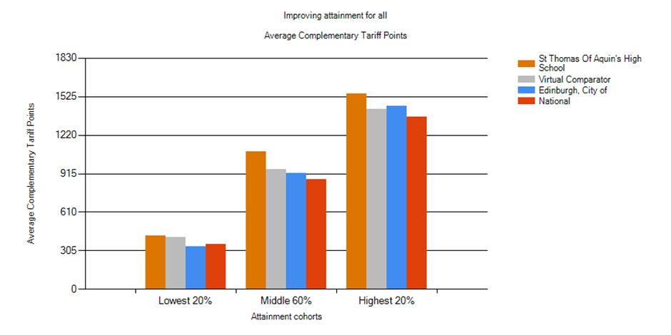
St Thomas of Aquin’s Attainment Report: Improving Attainment for All – S6 (all candidates) This is a significant improvement from last year, all areas beating the VC and Middle 20% and Highest 20% is a significant gap. Why? Progression. Teaching. Coursing. 5 @ L6 is 71%, up from 51% in 2017-18 – is this the figure Newspapers use? 2016-17 5@ Level 6 was 60% 1@ L7 is 58%, up from 45% in 2017-18, and 51% in 2016-17
Awards | Level 6 | Level 7
1 or more | 89.58% | 58.33%
2 or more | 87.50% | 40.63%
3 or more | 85.42% | 18.75%
4 or more | 78.13% | 2.08%
5 or more | 70.83% | 0.00%

Slide 11
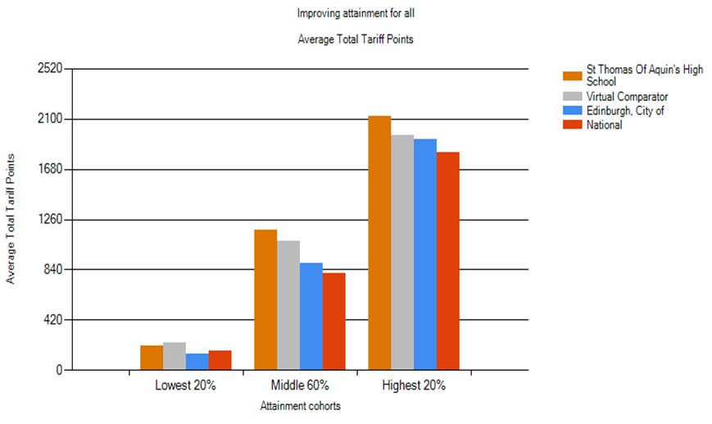
St Thomas of Aquin’s Attainment Report: S6 Improving Attainment for All – S6 (all candidates) Average tariff points based rather than complimentary tariff score
2018-19 Data: S6 attainment based on S4 cohort numbers
S6 St Thomas of Aquin’s Lowest 20%, Middle 60%, and Highest 20% statistic: 202/1170/2123
S6 VC Lowest 20%, Middle 60%, and Highest 20% statistic: 233/1076/1965
S6 CEC Lowest 20%, Middle 60%, and Highest 20% statistic: 138/892/1931
S6 National Lowest 20%, Middle 60%, and Highest 20% statistic: 158/813/1818

Slide 12
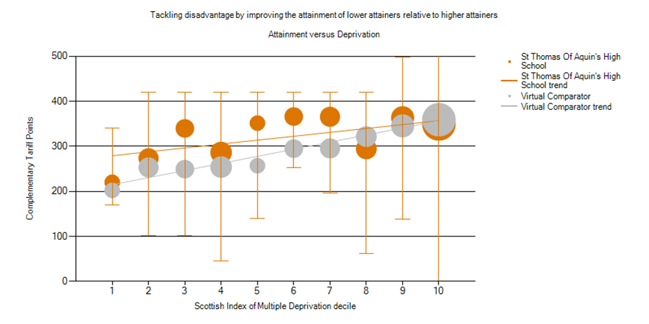
St Thomas of Aquin’s Attainment Report: S4 Improving Attainment for All – S4 (all candidates) Lowest 20% & Middle 60% improved from 2017-18 attainment - Curriculum (8 to 7 Nationals) & S4 at risk focus? 2018-19 5@ Level 5 67% is the school’s highest attainment in S4

Slide 13
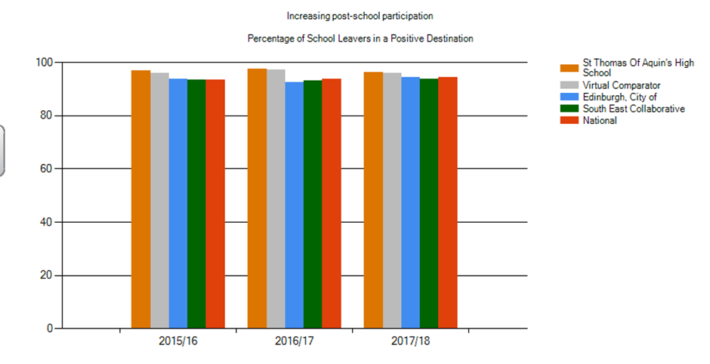
2018 February Positive Destinations

