Slide 1
International Women’s Day
8th March
Theme 2021
Choose To Challenge
Despite the pandemic the day is celebrated by many exciting and impactful events worldwide, many are virtual.
Click

Slide 2
The day is celebrated and supported globally by industry, governments, educational institutions, community groups, professional associations, women's networks, charities and non-profit bodies, the media and more.
It highlights women's equality, launch new initiatives and action, celebrate women's achievements, raise awareness, highlight gender parity gains and more. It is a global day celebrating the social, economic, cultural and political achievements of women.
A challenged world is an alert world and from challenge comes change.
So let's all choose to challenge.
How will you help forge a gender equal world? Celebrate women's achievement.
Raise awareness against bias (see next page for explanation)
Take action for equality.
Click

Slide 3
Bias is holding women back in the workplace
73% of women experience bias at work. Less than one third of employees are able to recognize bias. Whether deliberate or unconscious, bias makes it harder for women to get hired and promoted and negatively impacts their day-to-day work experiences
There are always the same colours symbolising International Women's Day:
Purple signifies justice and dignity.
Green symbolises hope.
White represents purity, albeit a controversial concept.
The colors originated from the Women's Social and Political Union (WSPU) in the UK in 1908.

Slide 4
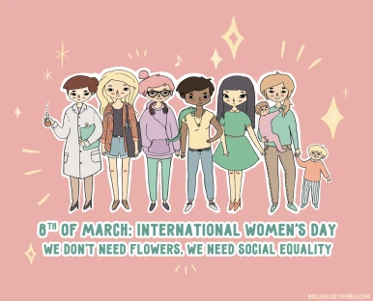
If you want to read more facts about over a hundred years of history of the International Women’s Day please visit:
https://www.internationalwomensday.com/Activity/15586/The-history-of-IWD
For more information about events, access resources and many more, please visit: https://www.internationalwomensday.com/
Before we finish please click on the picture below to watch video

