Slide 1
RE & Chaplaincy Newsletter
December 2022

Slide 2
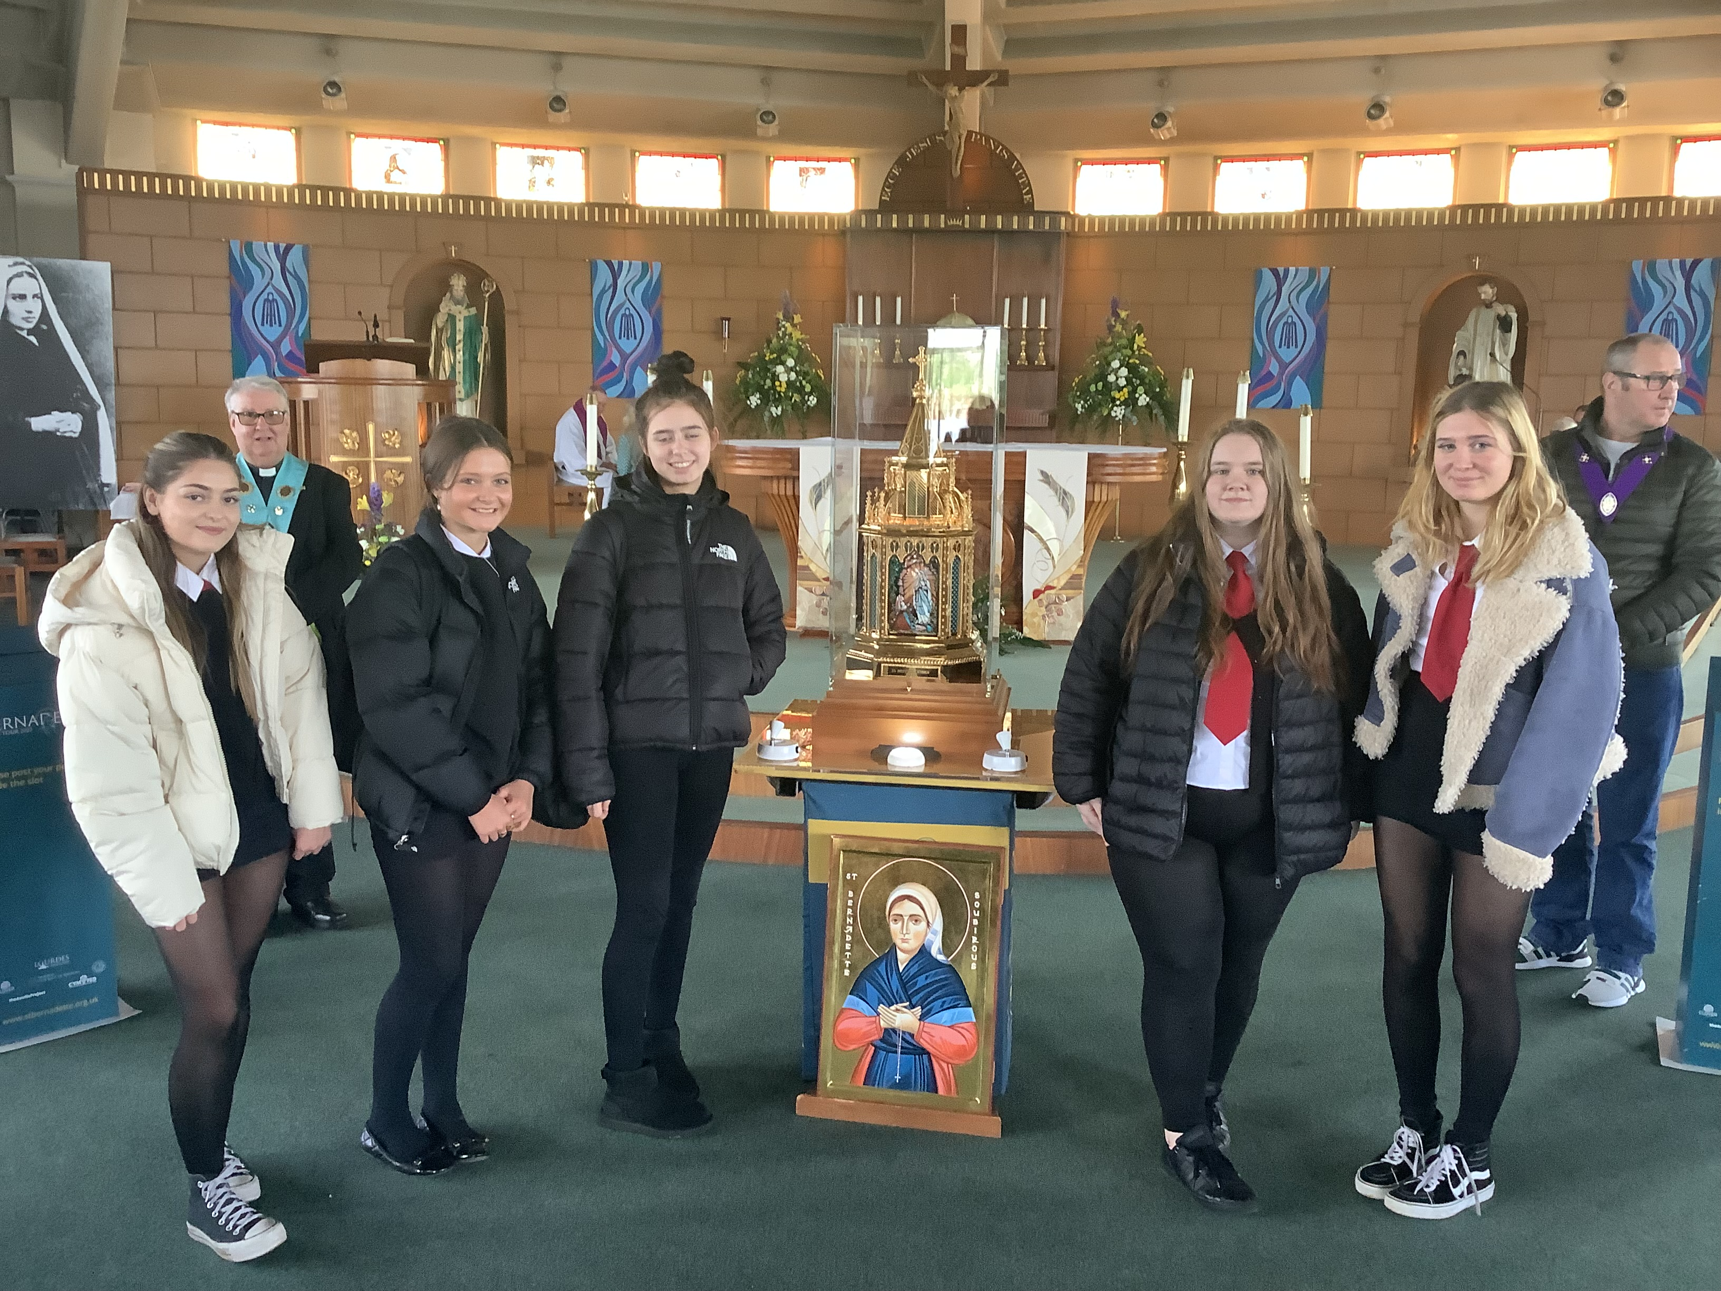
Carfin Grotto 29 September
Visit of the relics of Saint Bernadette at the National Marian Shrine of Scotland and Mass with Archbishop Cushley.

Slide 3
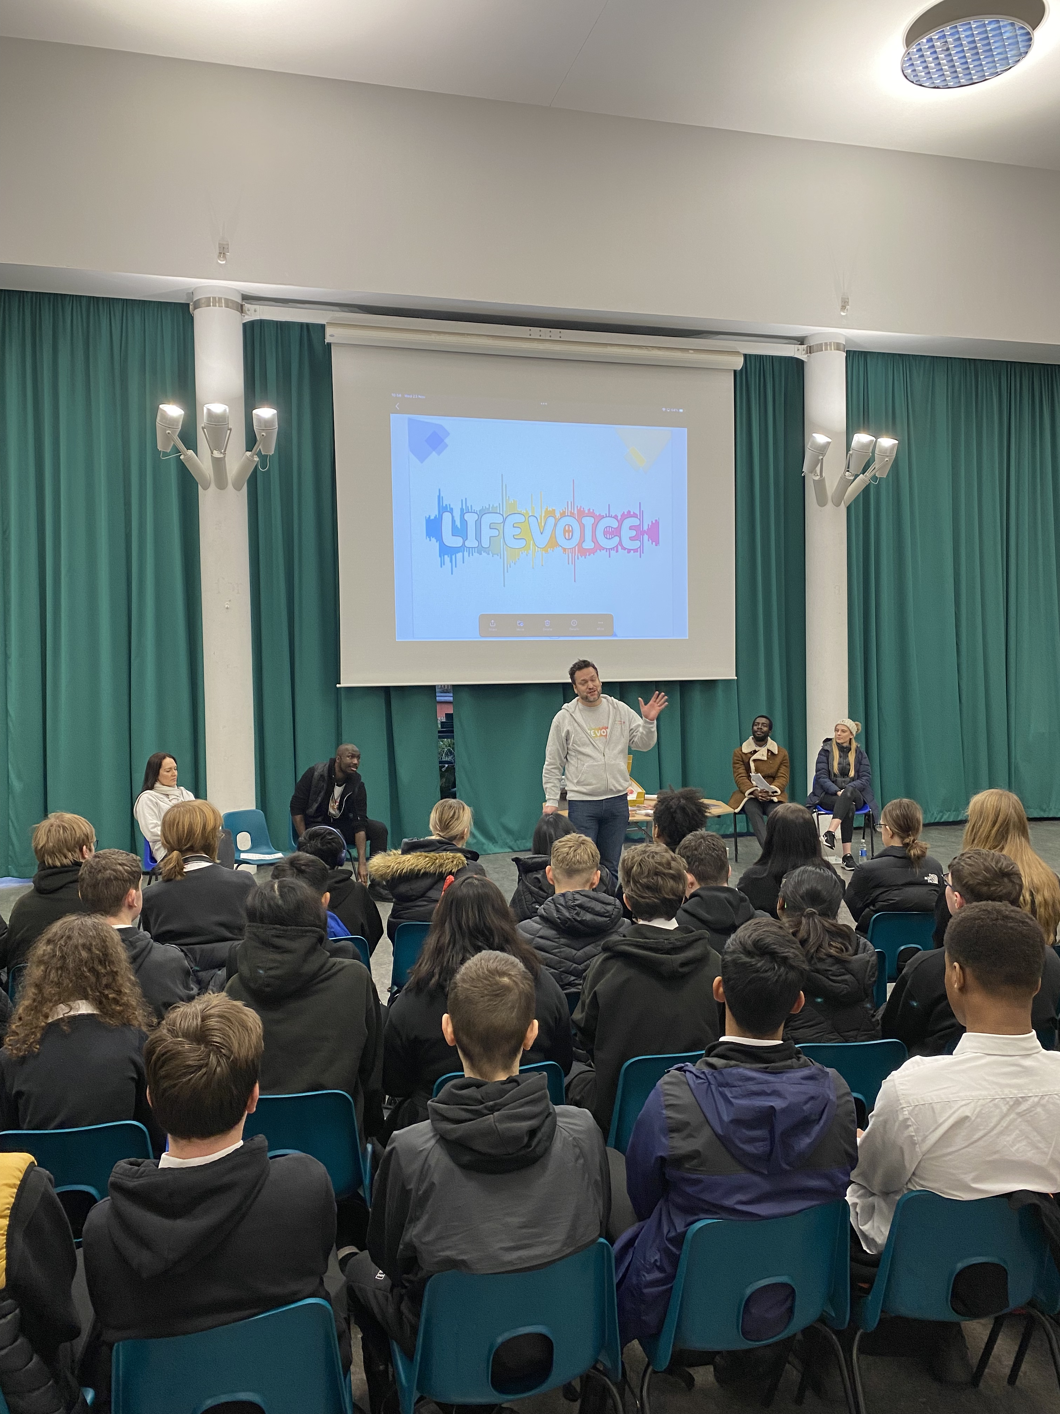
Life Voice Drama and Workshop 21-23 November
Drama about crisis pregnancy, followed by workshop on the development of life in the womb and Catholic teaching on the sanctity of life.
Part of the Called to Love relationships programme for S4-6.

Slide 4
Assembly on Saint Andrew

Slide 5
Remembrance Services Throughout November
Mr Wotherspoon and Ms Luncanu led remembrance services for pupils in the Oratory. Pupils and staff were invited to pray for the dead and include their names in our Book of Remembrance.

Slide 6
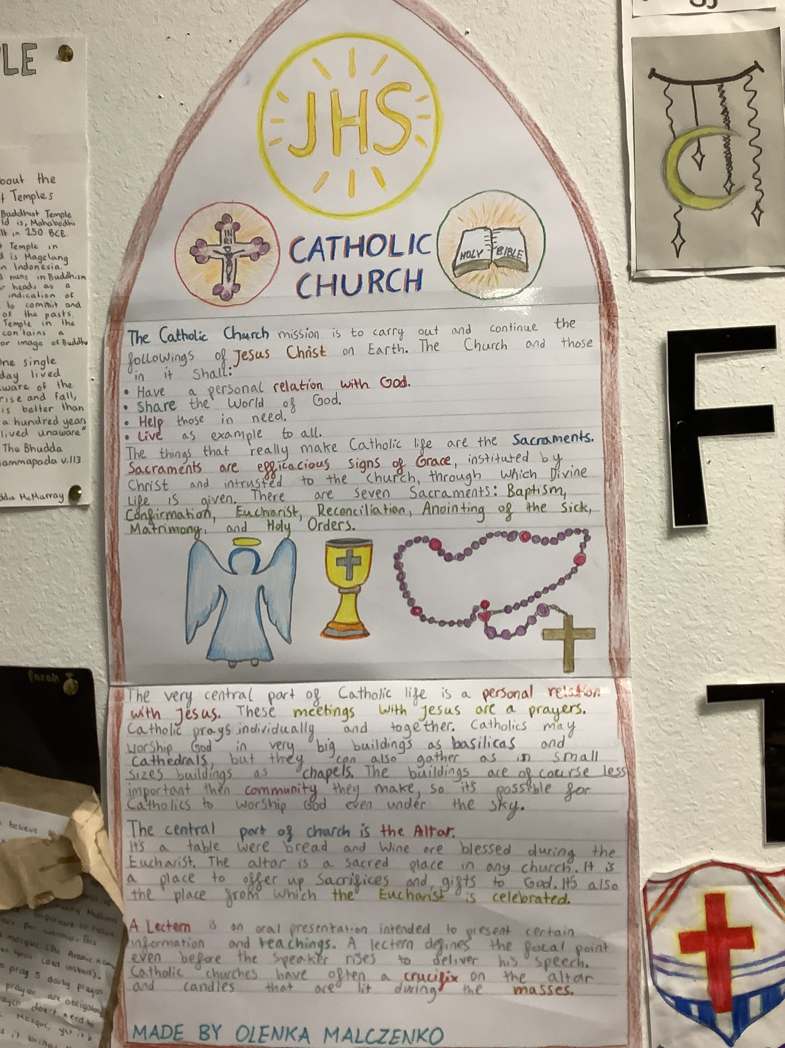
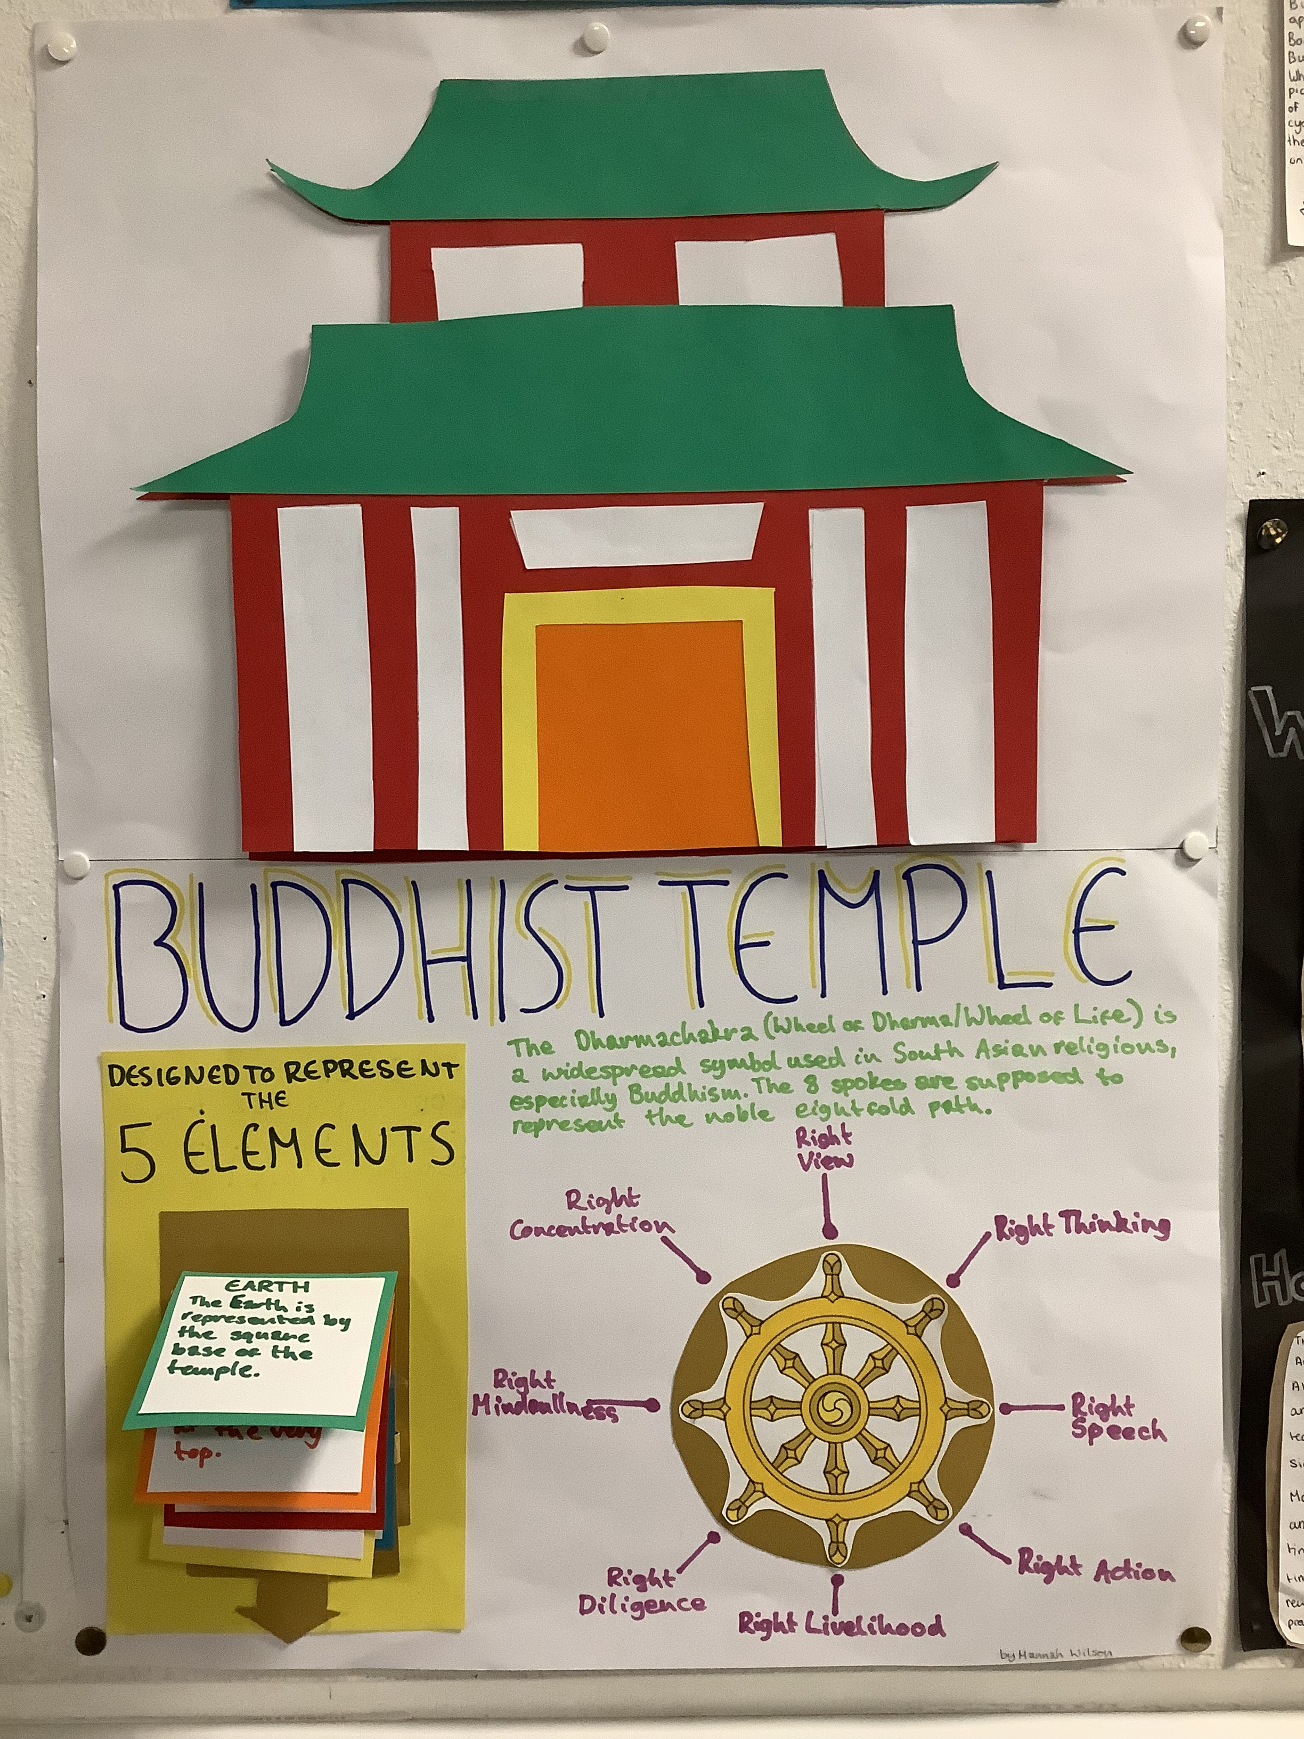
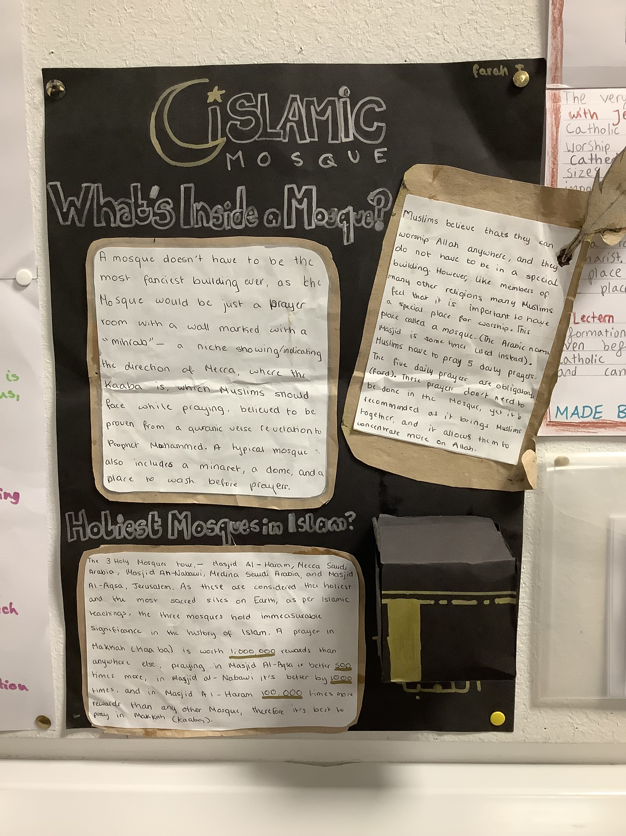
Places of Worship Unit
S2 pupils produced some fantastic project work on Places of Worship in RE.

Slide 7
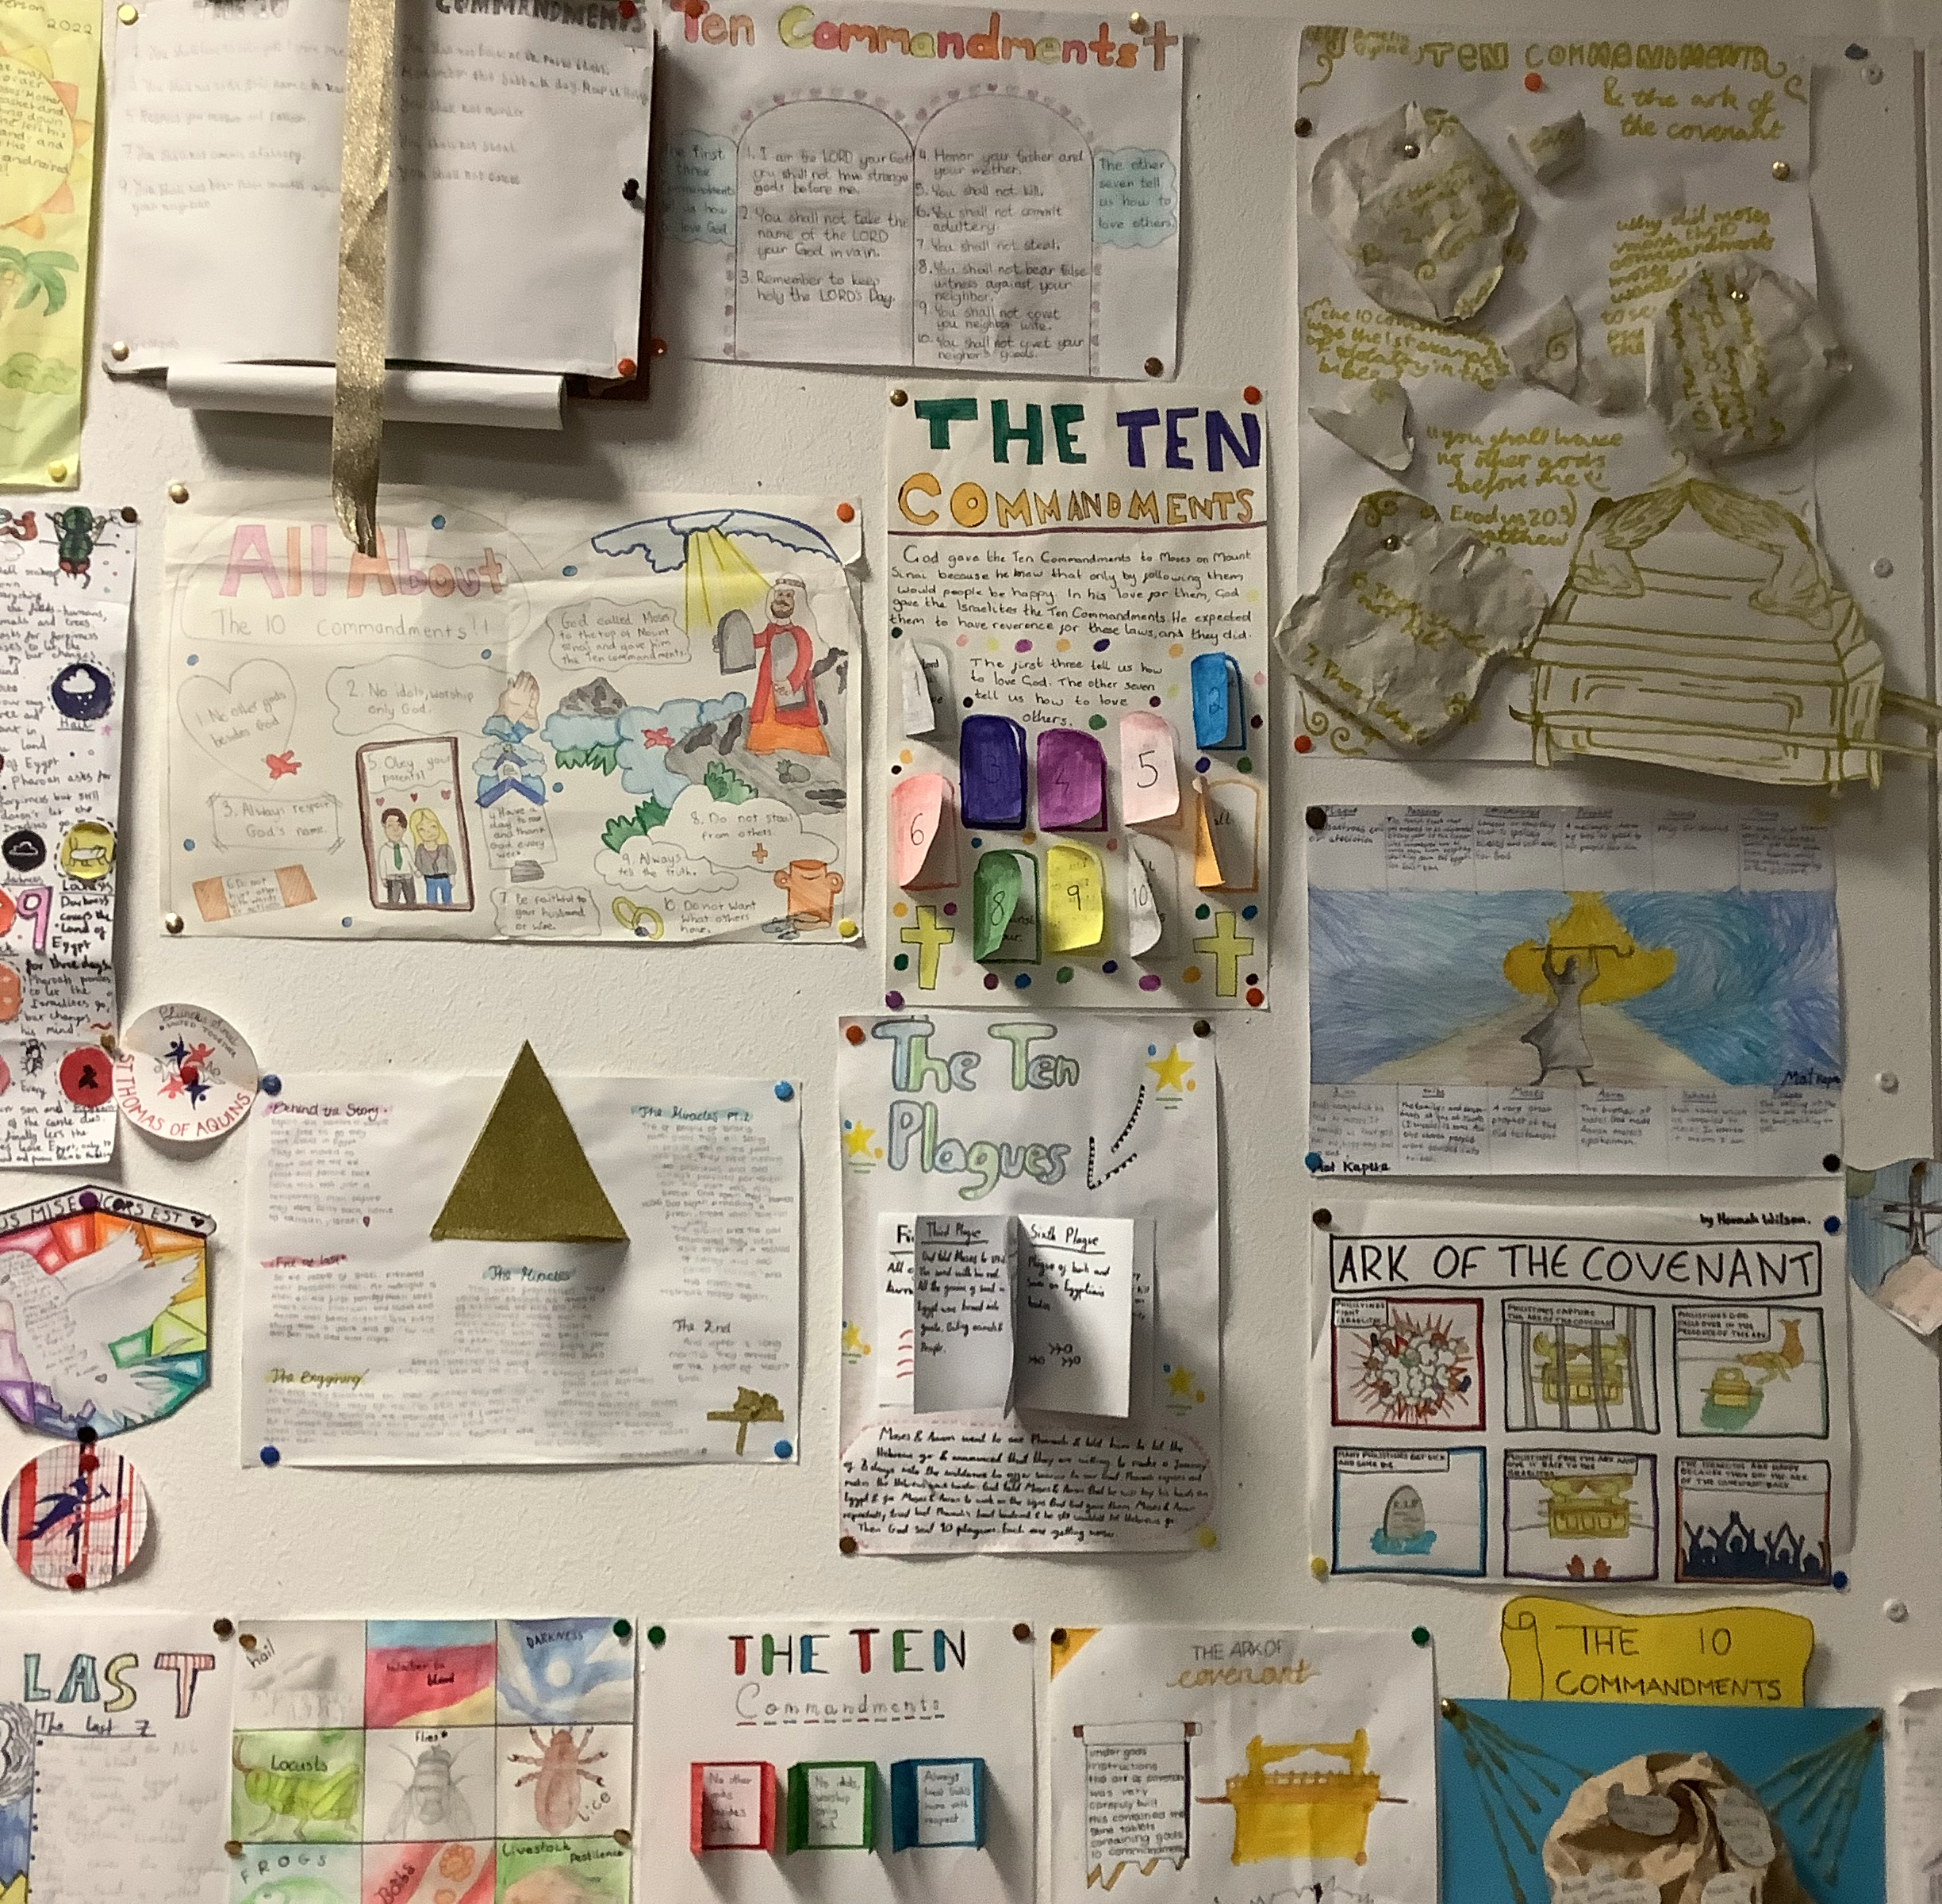
The Ten Commandments S1 have been learning about God’s covenant with Moses on Mount Sinai

Slide 8
S1 RE Class

Slide 9
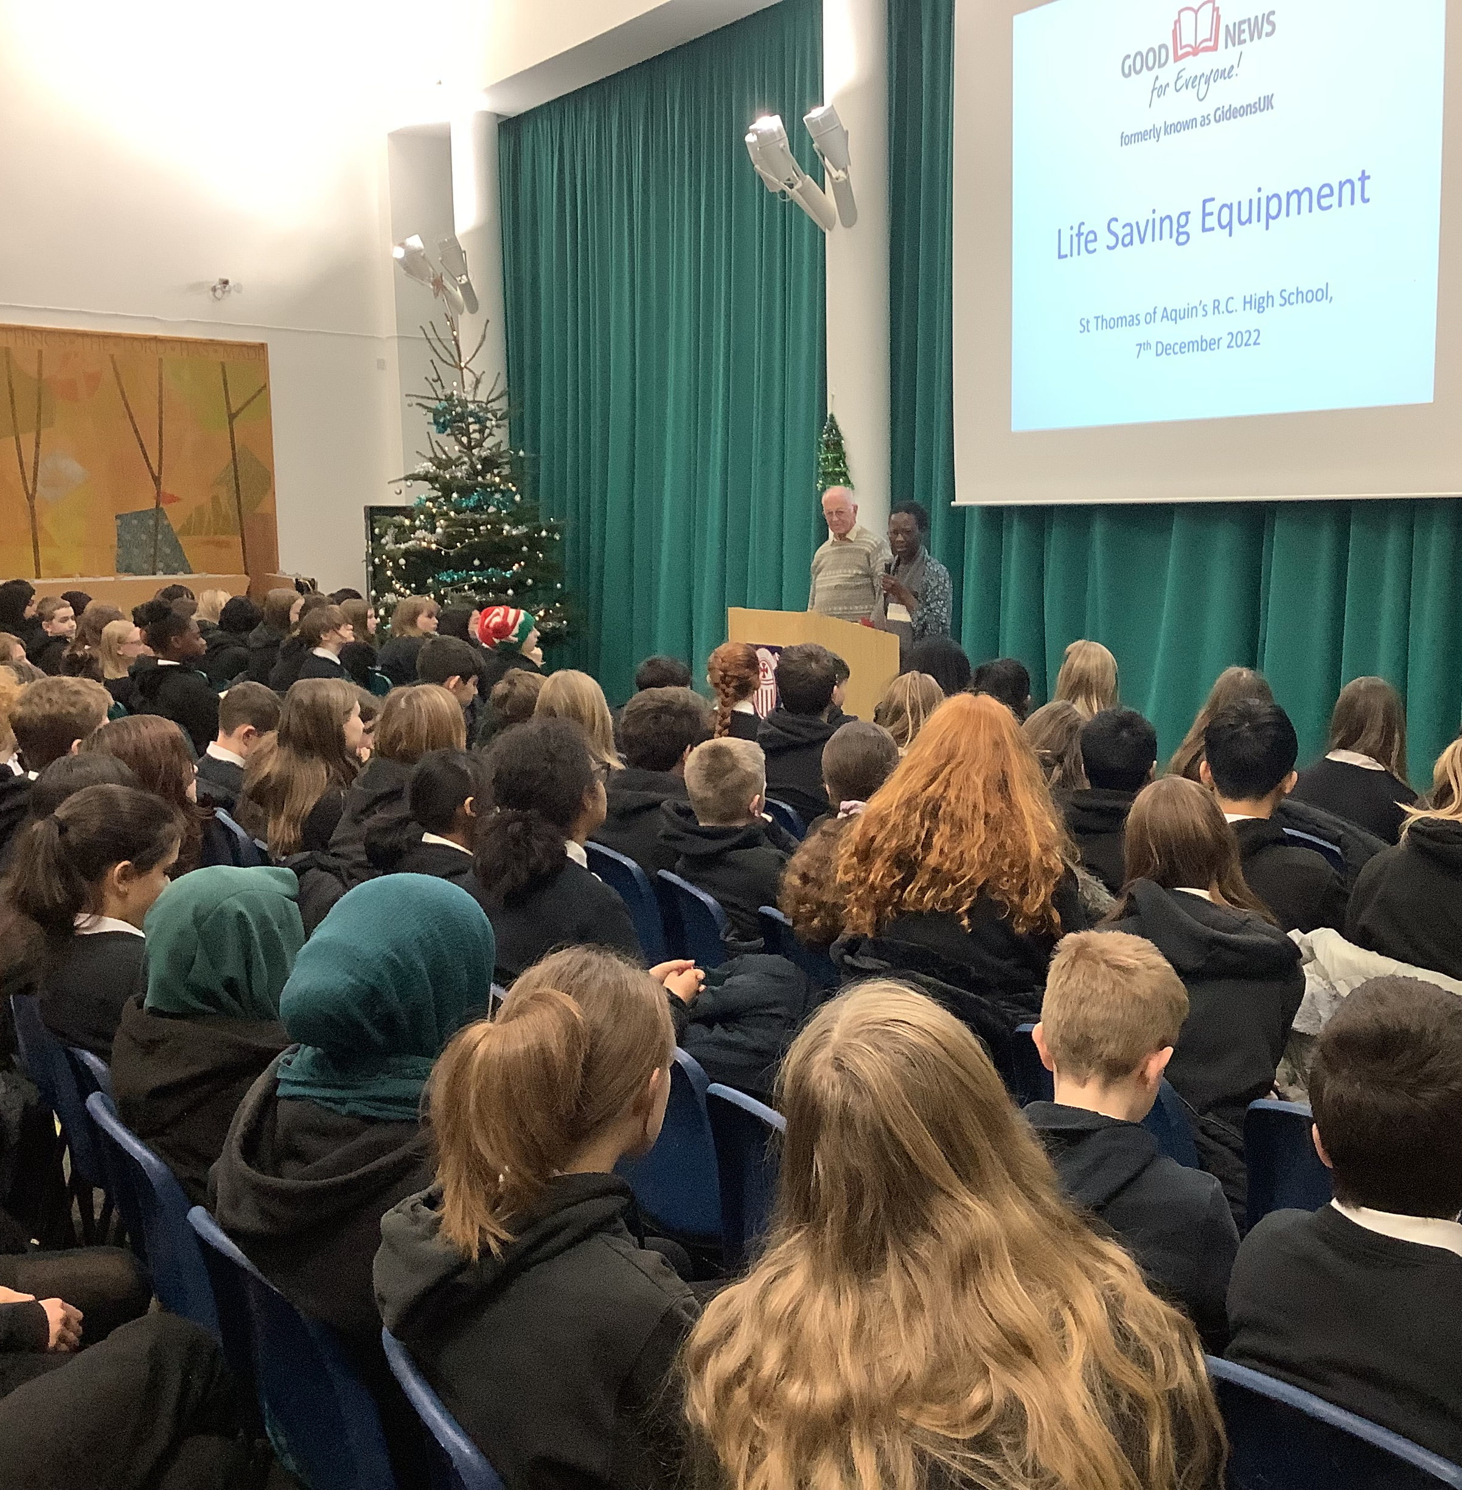
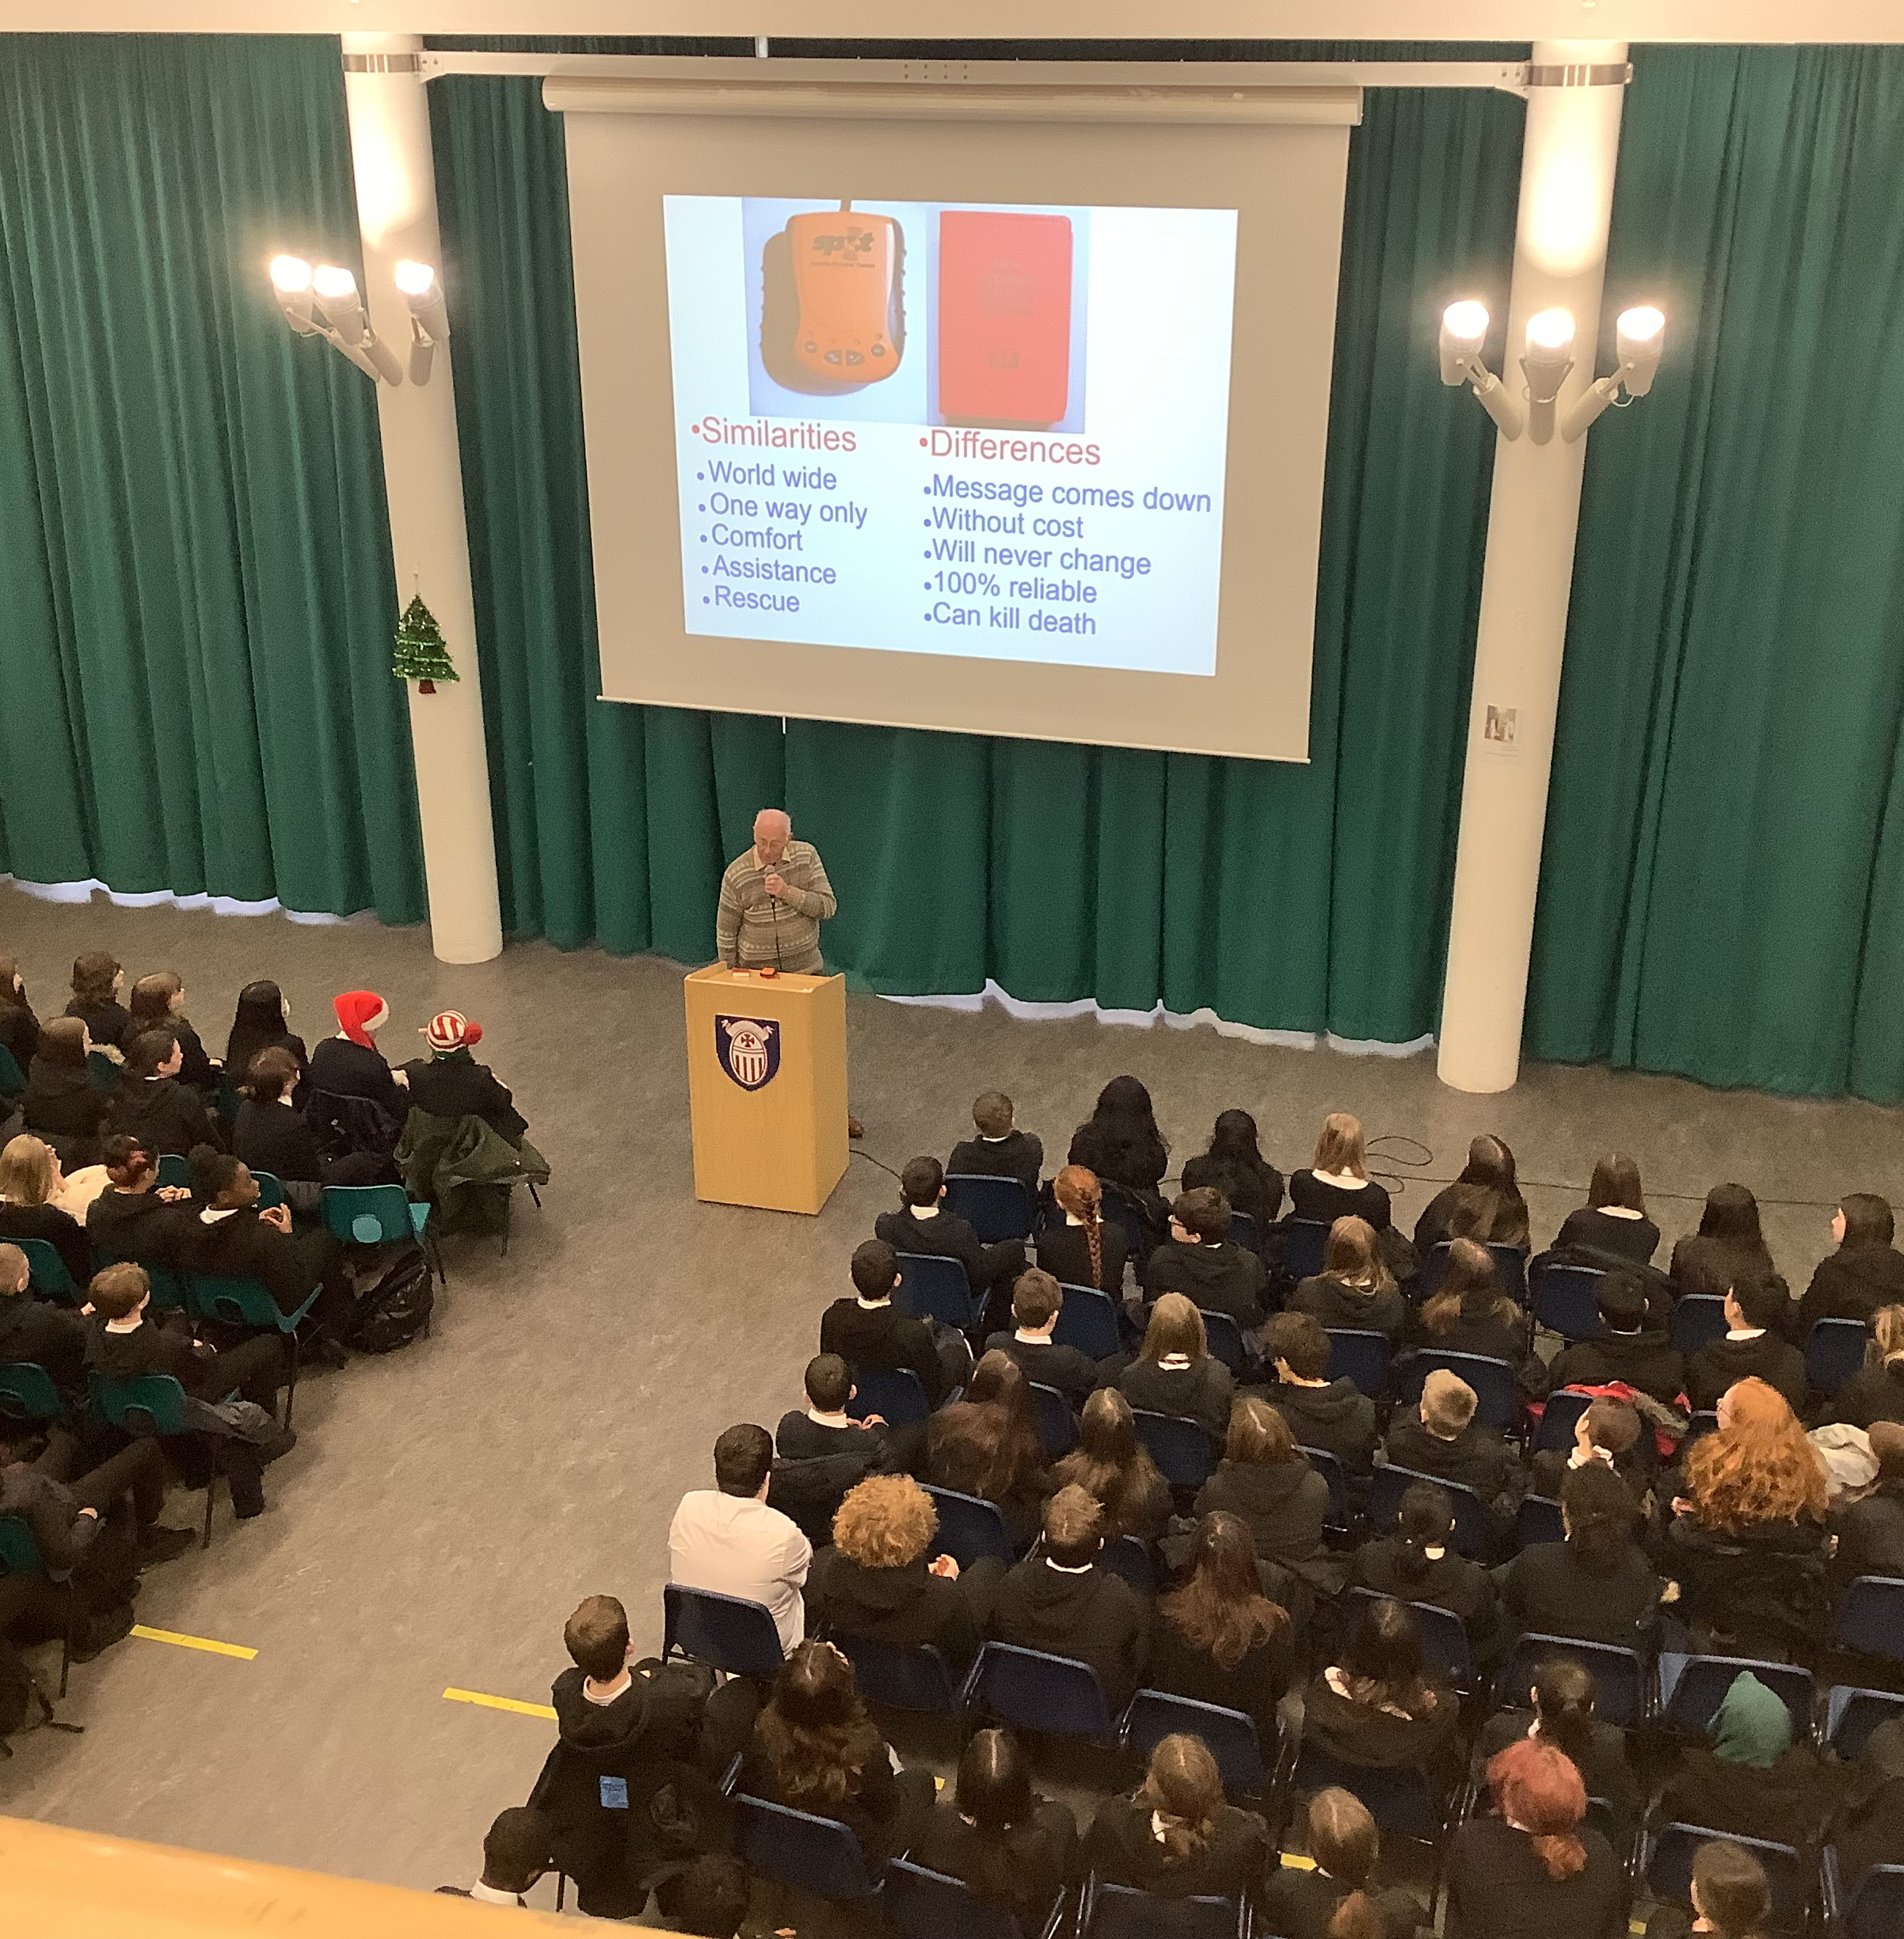
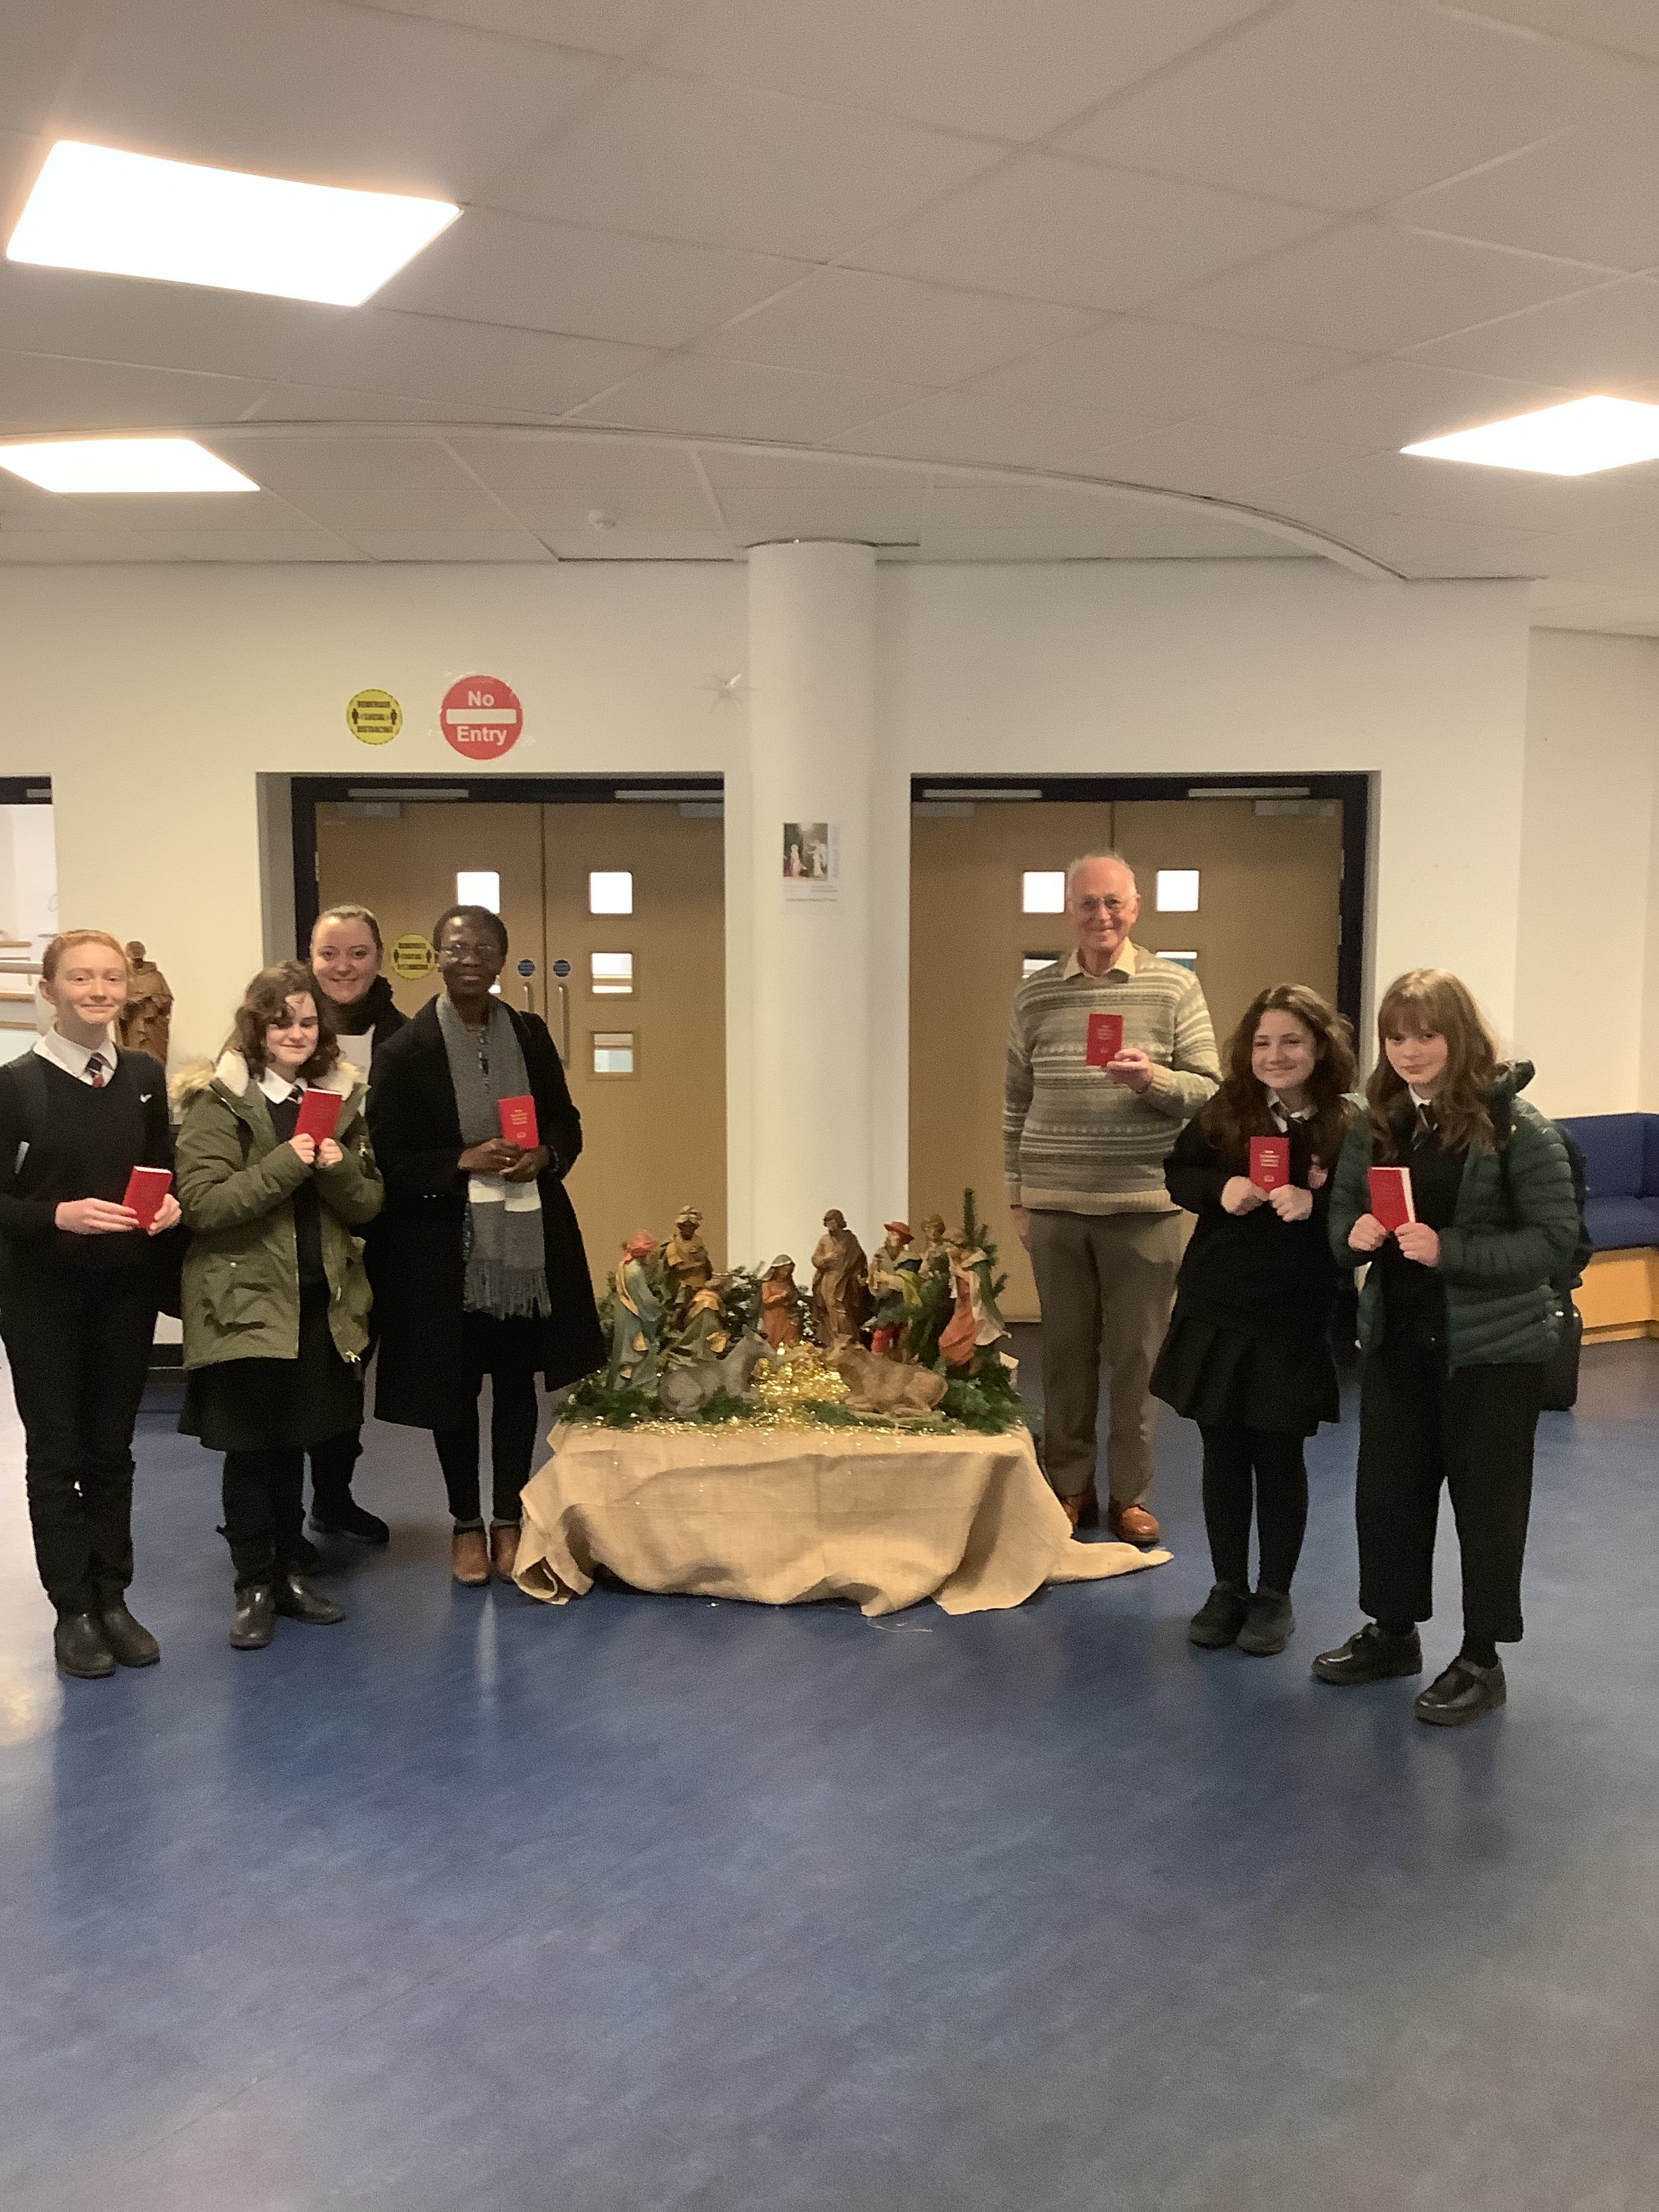
Gideons Assemblies for S1 & 2 5 December
We were visited by David and Esther from the Gideons who gave assemblies on the importance of the Bible. Pupils were then offered a free copy of the New Testament and Psalms.

