Slide 1
NET Ministries Retreats
22-24 February 2023
St Thomas of Aquin’s RC High School, Edinburgh

Slide 4
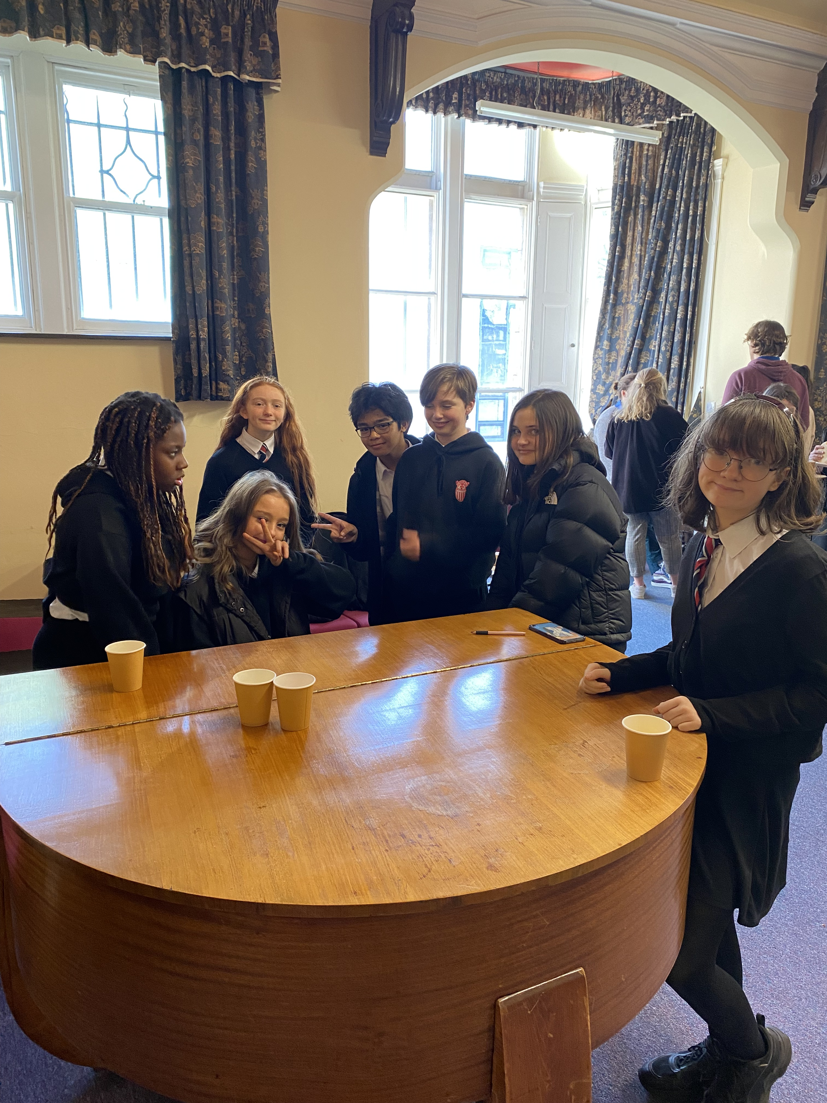
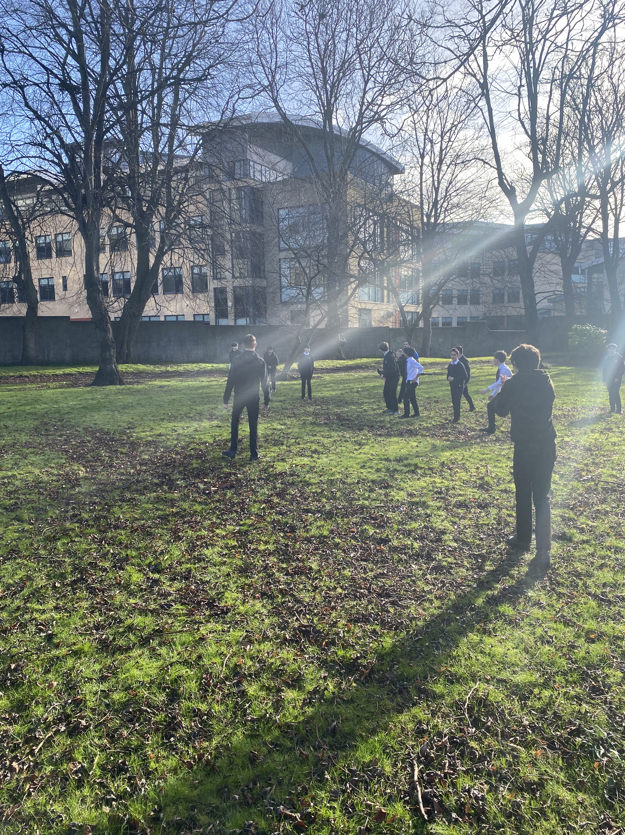

Slide 6
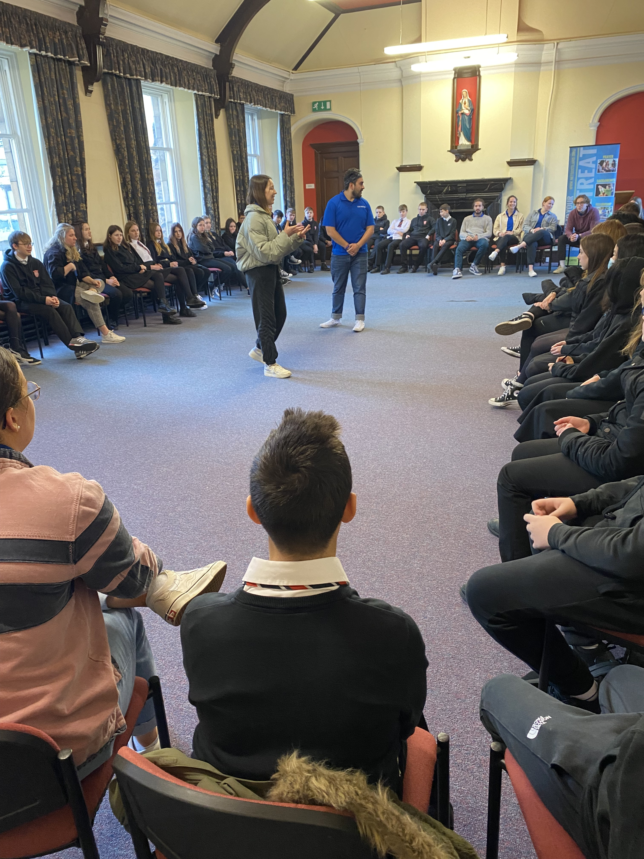
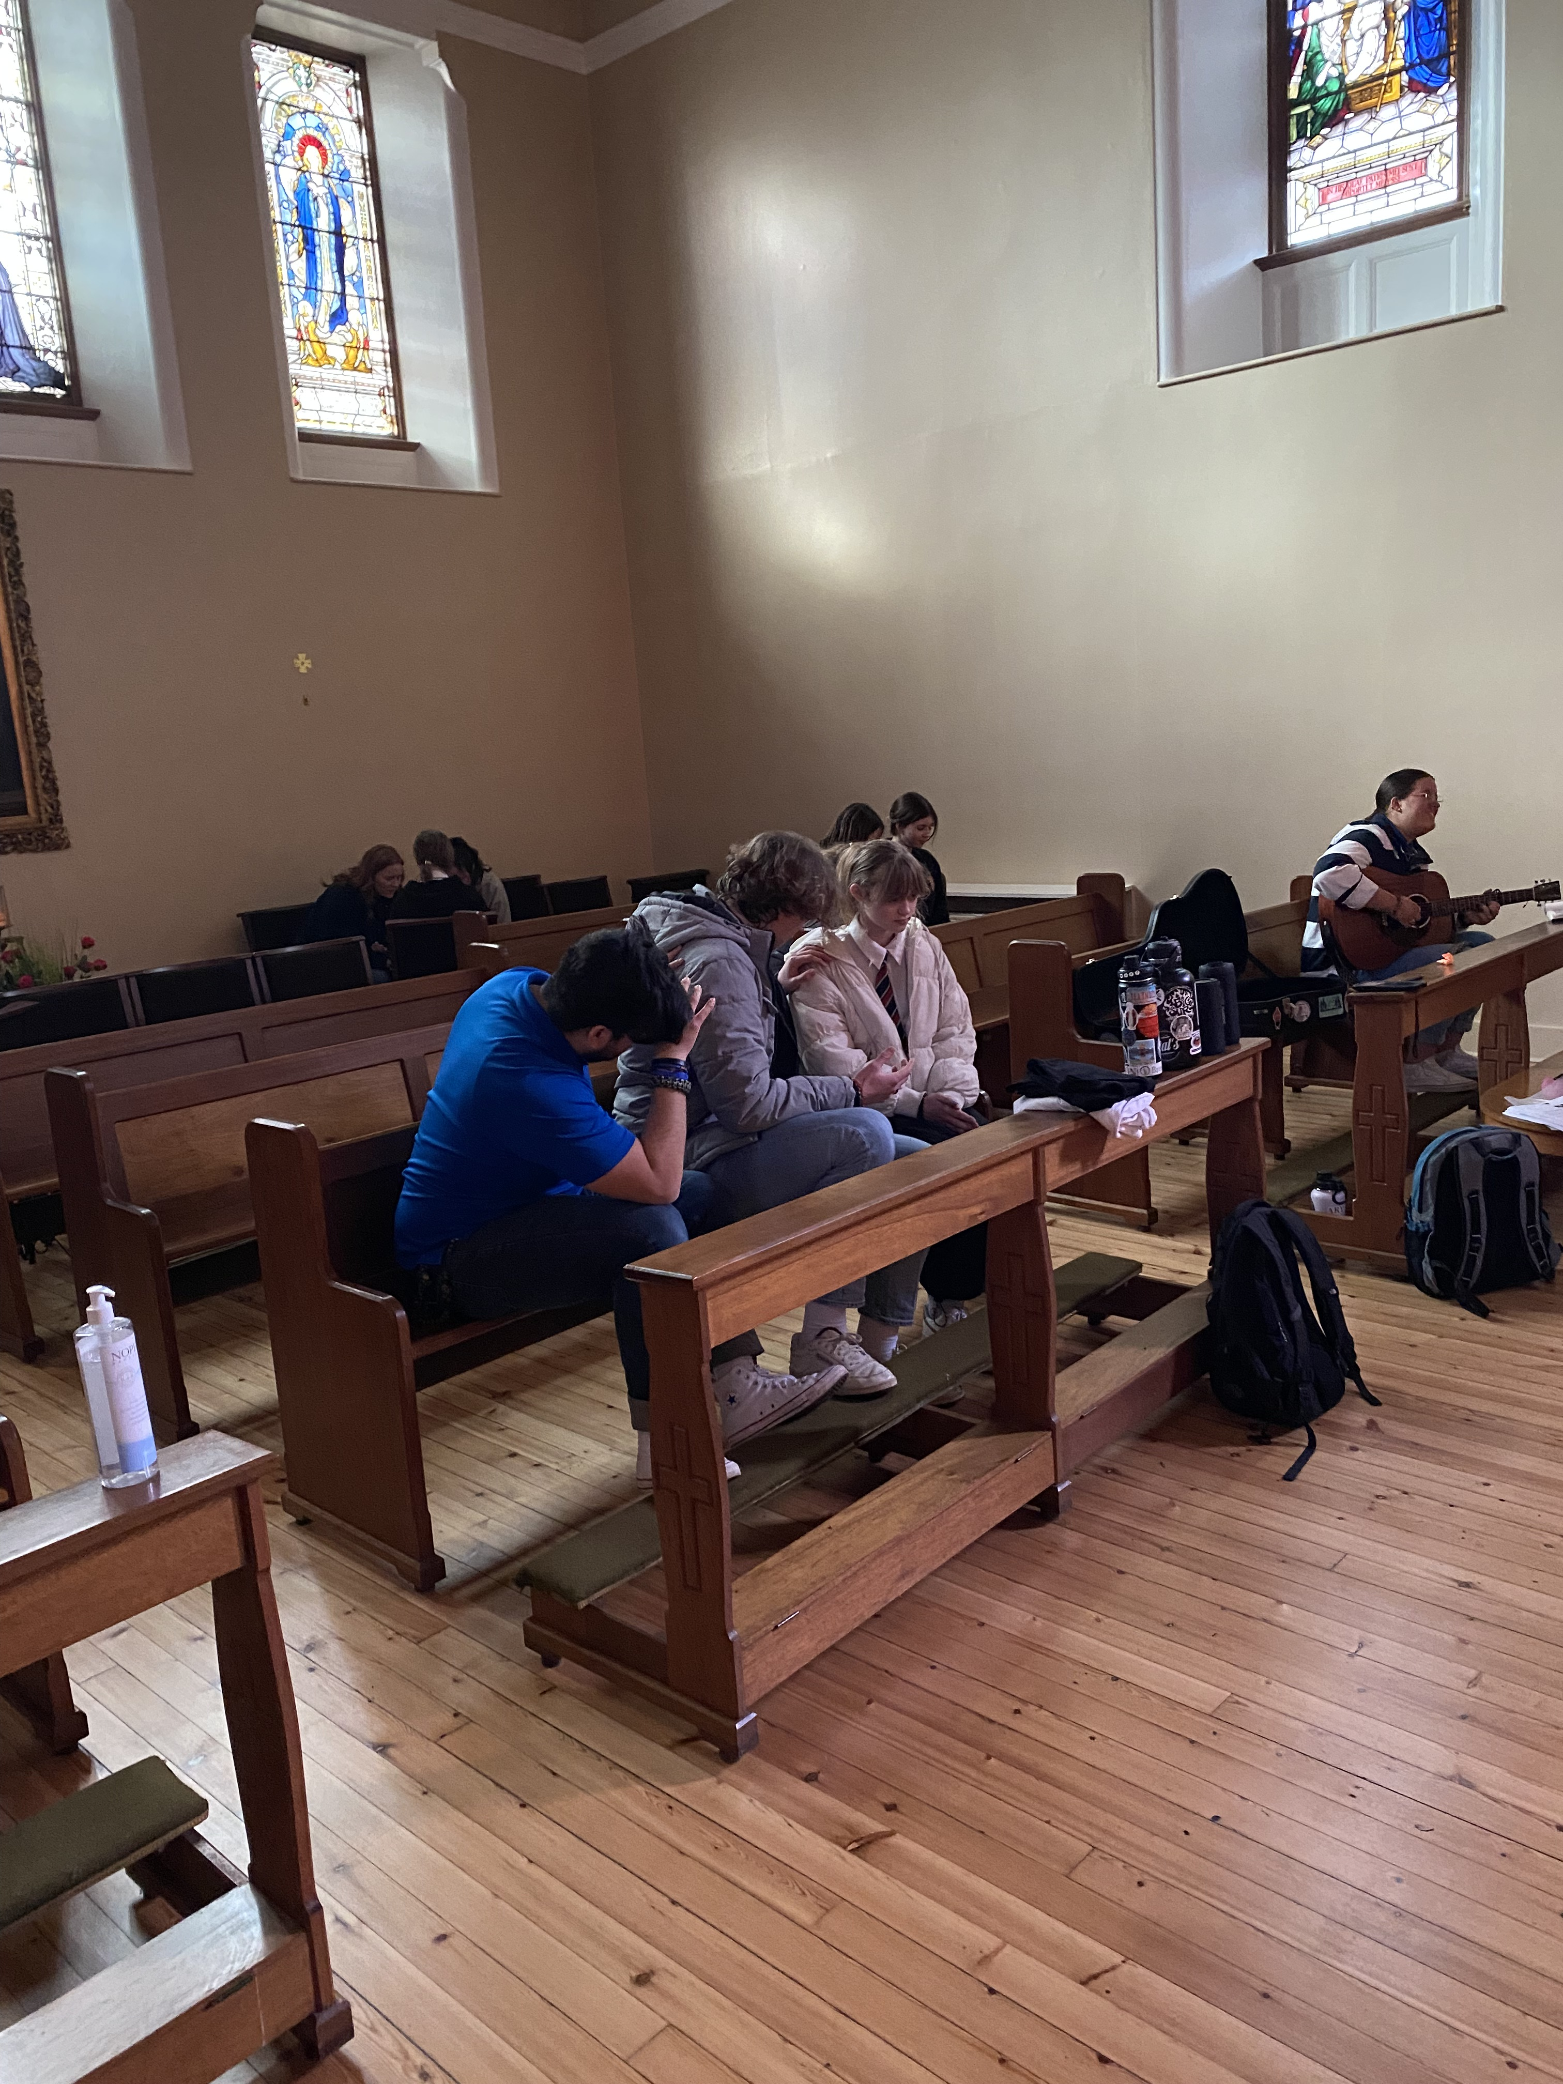

Slide 8
